Slide 1
stokk
Integrated home database application
Key functionality- shopping list/ recipe handling/ storage handling

Slide 2
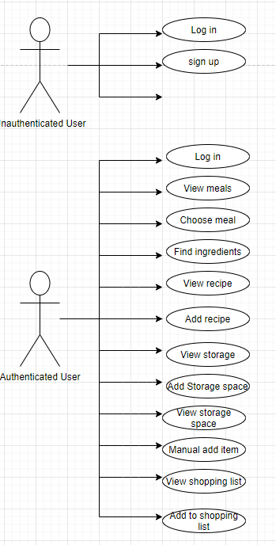
Initial idea and functionality
Key functionality- shopping list/ recipe handling/ storage handling
User can add/edit/delete storage spaces (cupboards and fridges).
User can view storage spaces and items in each storage space
User can view shopping list (shopping list is updated when items qty = 1 or 0)
User can see items that are needed straight away and items that are getting low
User can add/edit shopping list
User can view recipes (separated by meals they have the ingredients for and not)
User can choose recipe and application says where each ingredient is
/if the user requires ingredients show which ingredients needed.

Slide 3
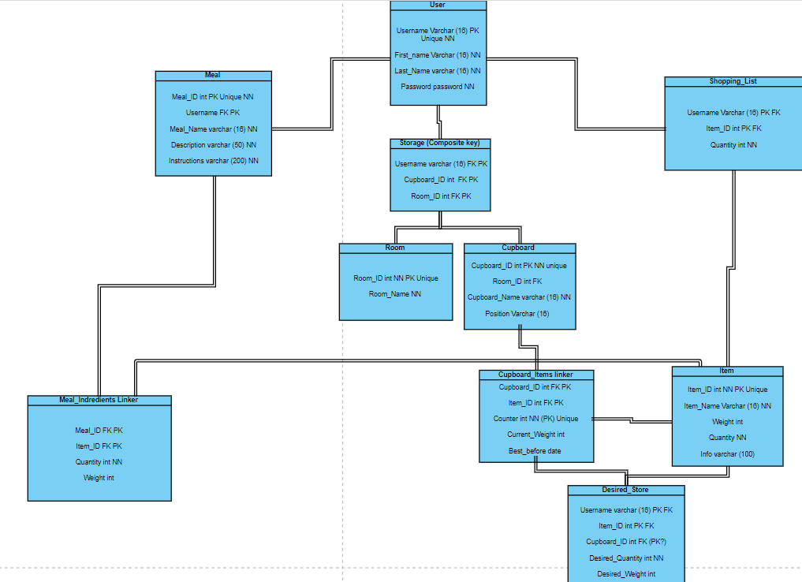
Initial ERD

Slide 4
Architecture
Originally desired it to be a mobile application.
Database is Microsoft SQL
API currently is ASP.NET RESTful (Database first, using ADO model)
the initial front end was created with Xamarin as a mobile application was wanted
Currently looking into creating web front end
Currently using Postman to test the api endpoints
Currently user functionality is being developed

Slide 5
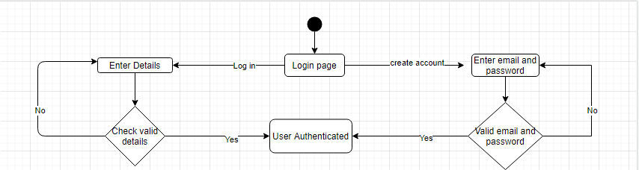
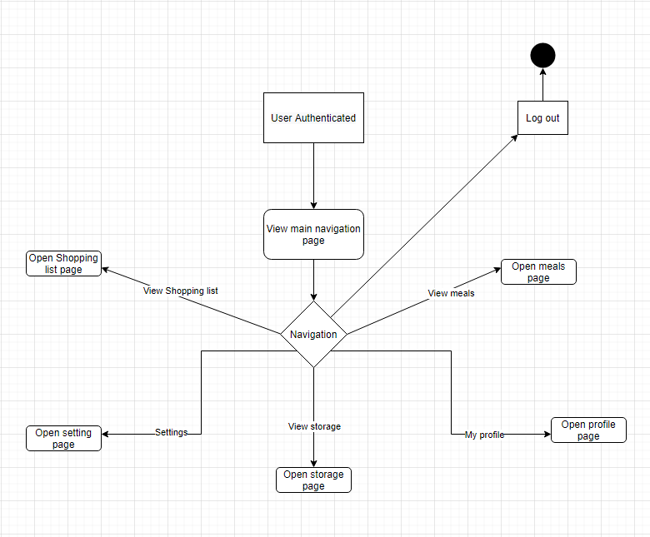
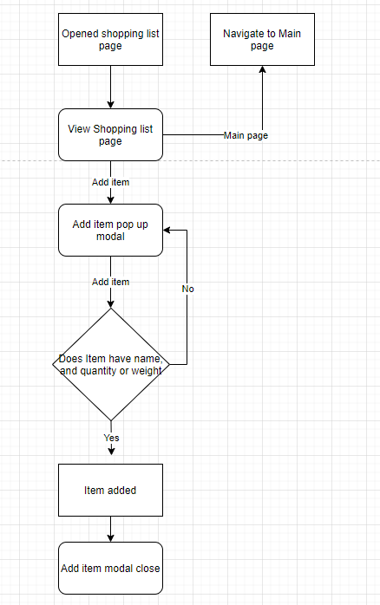
Activity/ state diagrams
Login/ signup
Navigation page
Shopping list

Slide 6
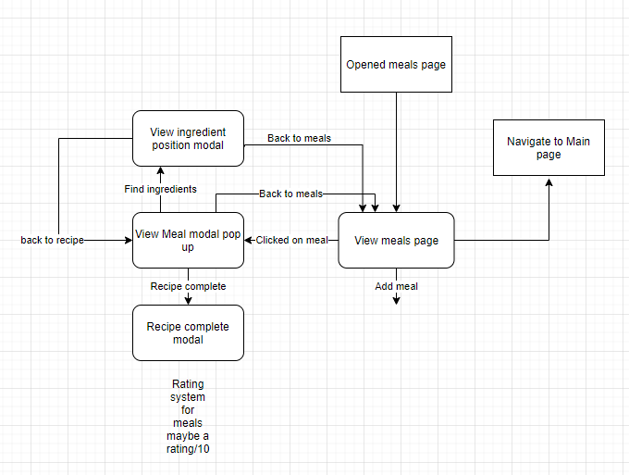
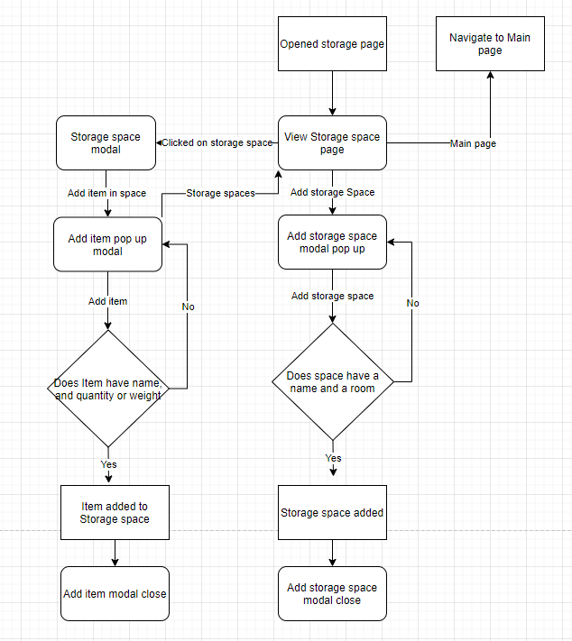
Meals functionality
Storage space functionality

Slide 7
Issues
Using an amd processor in my desktop could explain the issues with emulator
Tried Xamarin using laptop that has intel cpu, On different machine Every version of NuGet packages attempted always thrown version error.
This is where I decided to try and make a web based front end.
Initially tried using API application to create front end, used web form but had issues taking user input.
Tried using cshtml (razor) pages but had issues with event handling.

Slide 8
questions
What would be the best way to approach web based front end with current architecture?
Is it possible to create front end using ASP.net alone?
Is current architecture fine if wanting to make web application?
Is it possible to do pop up modals with web front end.

